Slide 1
Hashing:
Hashing techniques, Hash table, Hash functions. Collision handling and Collision resolution techniques, Cuckoo Hashing. Dynamic Hashing: Motivation for Dynamic Hashing, Dynamic Hashing using Directories, directory less Dynamic Hashing. Bloom Filters Bloom Filter Design

Slide 2
Hashing
Hashing is a technique or process of mapping keys, values into the hash table by using a hash function. It is done for faster access to elements. The efficiency of mapping depends on the efficiency of the hash function used.
Mapping is the way of linking 2 things together, referred to as “Key” and “Value”.
Key is an Identifier to uniquely identify the Data(Entity).
Value – The Actual Entity(and its details) which we want to store.

Slide 3
Hashing
Hashing is a way where we can get an Integer value from any Key. This Key may or may not be an integer, but after hashing is performed, it will return an Integer value for any Key.
Hashing is required as the Key which was given in the input can not be used as the memory location to place this key value.
Hashing in Data Structure is an important method designed to solve the problem of efficiently finding and storing data in an array.

Slide 4
Hash Table
Hashing in data structure uses hash tables to store the key-value pairs.
Suppose we want to store some data(i.e. Value) identified by a unique Key, we can use the Hash Table.
E.g. If we need to store 3 students with their Roll number as 302, 312, 342, then we need the array of size at least 343, so that these 3 students are placed at 302nd, 312th and 342nd Index of that table.
So instead of directly storing the keys in the hash table, hashing comes into play, which runs the hash function converts these big Keys to the Integer value <= size of Array, this Integer value is called Hash Index

Slide 5
Techniques to Calculate Hashing
The hash function is just a mathematical formula that can give a small Integer value(within the array size) for some big keys.
Division Method
Multiplication Method
Universal Hashing
Folding Method
Mid Square Method

Slide 6
Division Method
This is the easiest of all the methods to understand.
Consider a scenario where we only have 10 cells in Array, and the Key to insert is 15. i.e. > 10. Then we need some way to find a method that takes 15 and returns an index < 10. Modulus operators can do this pretty easily.
Division method: HashFunction = Key % size Here % = Modulus Operator which returns the remainder when Key is divided by Size.
E.g. if key=15, 15%̲10=5 and 5<10 so we can insert this Data with key=15 at the 5th index of the array of size 10.

Slide 7
Multiplication Method
Similar to Division, it uses the function like:
h(k) = floor( n( kA mod 1 ) )
Here, k is the key and A can be any constant value between 0 and 1. Both k and A are multiplied and their fractional part is separated using the modulus operator. This is then multiplied with n to get the hash value.

Slide 8
Multiplication Method
Example:
k=123 n=100 A=0.618033 (Has to be between 0 and 1)
h(123) = 100 (123 * 0.618033 mod 1)
= 100 (76.018059 mod 1)
= 100 (0.018059) = 1
So K with Key=123 can be placed at Index 1.

Slide 9
Universal Hashing
Universal hashing means that we don’t use a fixed hash function, but there is a family of hash functions from which we can randomly pick any hash function.
These hash functions must obey the basic principle of Universal hashing that the expected number of collisions for a particular key x is < 1.
Once we have such a family of hash functions, then any hash function can be chosen out of this, at runtime. This brings randomness to the hash functions, and hence it favors the most evenly spread amongst all other hashing techniques.

Slide 10
Folding Method
Folding method folds the given key in a way to find such an index that can fit in the given size of the array.
By folding, if the array size = 100, that means 2-digit numbers can only fit inside it, so we fold the given key in parts of 2. i.e if Key=20574 Then we will fold it in parts of 2, which will be:20, 57, and 4. So to get an index < 100 from these parts, we can sum these up i.e. 20 + 57 + 4 = 81. So 81 is the index where this Key=20574 can be placed.
There can be cases where even after folding we get a number > size e.g. Key=56571 then breaking it down in parts of 2= 56+57+1=114 , we cant place this Data at index 114 inside the array of size 100, so we can either apply this algorithm again or can use the Division method(mostly used in such scenarios).
Similarly, if the array size = 1000, then we can insert 3-digit numbers, so then we can break Key=20574 as 205+74=279205+74=279
So Data with Key=20574 can be placed at 279th Index in an array of size 1000.

Slide 11
Mid Square Method
In this method, basically square the given number and pick N middle numbers in that squared number, to find the index.
E.g. If the array size = 100, meaning we can fit only 2 digit numbers, let’s take N=2 here (N can be taken anything).
Hash(931)=931^2=866761. Picking N(=2) middle elements i.e. 67, So 67 can be the potential index to place 93 at.
If the index obtained from the mid square method is > size of array, then we can again resort back to the Division method.
Let’s take N=2 and Array size=11. Hash(93) = 93^2 = 8649. Picking N(=2) middle elements i.e. 64 Now since 64>11, so we can apply the Division method to get 64%11=9. So 93 can be placed at 9th Index in the array of size 11.

Slide 12
Collision
The same index can be obtained by running the Hash Function on different keys.
For E.g.
If using the Division method: Let’s say the array size=10 Then Hash(15) = 15%10 = 5 And Hash(25) = 25%10 = 5 So this hash function will return 5 as the index for both of these keys.
This is called a Collision, where the resultant hashes of 2 or more Keys, wrongly map to the same place in the hash table. The collision creates a problem because each index in a hash table is supposed to store only one value

Slide 13
Collision resolution techniques
There are two fundamentals that can be used to tackle a hash collision:
Open Addressing
Rehashing
Linear Probing
Quadratic probing
2. Closed Addressing
Chaining

Slide 14
Open Addressing
Open addressing means where we try to resolve the collision by finding the alternative index to place the Key at.
Rehashing
Linear Probing
Quadratic probing

Slide 15
Rehashing
This method invokes 2 hash functions to get rid of collisions. These 2 hash functions can either be the same or different and the secondary hash function is applied continuously until an unused/vacant index is found.
E.g. Let’s take the Division Method as Primary and mid square as a secondary method.
Array size = 10.Key=15 Hash1(15) = 15%10 = 5, So 15 is placed at the 5th Index.
Key=25 Hash1(25) = 25%10 = 5,Since 5 is already used, it’s a collision.
Hash2(25) = 625. Picking 1 middle element we get 2. So 25 can be placed at the 2nd Index.
So as we can see, by using 2 different hash functions, we are able to place both 15 and 25 at the 5th and 2nd index respectively.

Slide 16
Linear Probing
When the collision occurs, using the Linear Probing technique, the closest free cell is found by linearly iterating over the cells. Here, the searching is performed sequentially, starting from the position where the collision occurs till the empty cell is not found.
Example- array of size 10, simple hash function hash(K) = (2K+ 1) % size
Input=2, hash(2) = (2*2+1) % 10 = 5 % 10 = 5
Input=7, hash(7) = (2*7+1) % 10 = 15 % 10 = 5
So calculated index of 7 is 5 which is already occupied by another key, i.e. 2. When linear probing is applied, the nearest empty cell to the index 5 is 6; therefore, the Key=7 will be added at the index 6.
Input=12, hash(12) = (2*12+1) % 10 = 25 % 10 = 5
As the 5th Index is again occupied with Key=2, we can’t place 12 at 5, so we will again need to linearly probe from 5.
Similarly, the 6th index is also occupied with Key=7, we look for the next Free Index. The 7th index is free, so we can place Key=12 at the 7th Index.

Slide 17
Quadratic probing
Quadratic probing is similar to linear probing, but instead of moving one step at a time to find the empty cell to place this Data at, here the next slot is computed by adding the successive value of an arbitrary polynomial in the original hashed index. To put it simply, it means we can move in a Quadratic fashion.
E.g. From 5 we can go to 5+12 = 6 Then from 6, the next slot to check can be 6 + 22 = 10. And then next from 10 would be 10 + 32 = 19. So as we can see, we are moving from 5 → 6 → 10 → 19 Versus the 5 → 6 → 7 → 8 in case of Linear Probing.

Slide 18
Closed Addressing
Contrary to the Open addressing, where we found an alternative index incase of collision, here we place it at that index only using the Chaining technique.
Chaining

Slide 19
Chaining
The chaining method builds a Linked list of items whose key hashes to the same value. This method requires an extra link field to each table position. So if we compare it against Rehashing, it only uses 1 hash function, but how the Data is stored is different.
Example- Array size = 10. Key=15, Hash(15) = 15%10 = 5 So 15 is placed at the 5th Index.
Key=25, Hash(25) = 25%10 = 5, Since 5 is already used, it’s a collision.
But using the Chaining mechanism, we can place both 15 and 25 at the same 5th Index, by chaining 15 to 25.
So the 5th Index of Array will contain a Linked List of 15 → 25.

Slide 20
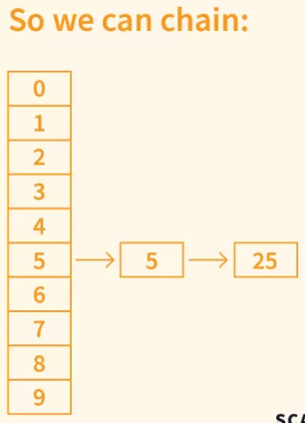
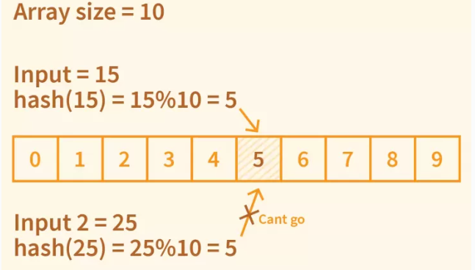
Chaining

Slide 21
Cuckoo Hashing
Cuckoo Hashing is a technique for implementing a hash table. As opposed to most other hash tables, it achieves constant time worst-case complexity for lookups.
Collisions are handled by evicting existing keys and moving them from one array to the other. This resembles the way a cuckoo chick pushes out an egg from the nest to make room for itself, hence the name Cuckoo Hashing.

Slide 22
Cuckoo Hashing
Representation-It is implemented using two arrays of equal size and two hash functions.
Insertion- a new element is always inserted in the first hash table. Should a collision occur, the existing element is kicked out and inserted in the second hash table. Should that in turn cause a collision, the second existing element will be kicked out and inserted in the first hash table, and so on. This continues until an empty bucket is found.
Lookup- if a key exists, it will be stored in its original bucket, either in the first array or the second one. In other words, at most two lookups are needed to figure out if the key exists or not, thus the worst-case complexity is O(1).
Removal- removal is done simply by clearing the bucket storing the key. Again, worst-case complexity is O(1).

Slide 23
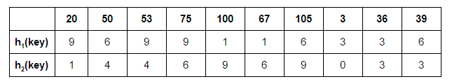
Cuckoo Hashing
Illustration-
Input: {20, 50, 53, 75, 100, 67, 105, 3, 36, 39}
Hash Functions: h1(key) = key%11
h2(key) = (key/11)%11

Slide 24
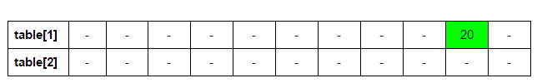

Cuckoo Hashing
Let’s start by inserting 20 at its possible position in the first table determined by h1(20):
Next: 50

Slide 25
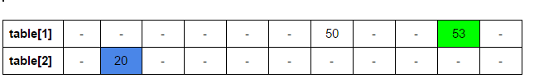

Cuckoo Hashing
Next: 53. h1(53) = 9. But 20 is already there at 9. We place 53 in table 1 & 20 in table 2 at h2(20)
Next: 75. h1(75) = 9. But 53 is already there at 9. We place 75 in table 1 & 53 in table 2 at h2(53)

Slide 26


Cuckoo Hashing
Next: 100. h1(100) = 1.
Next: 67. h1(67) = 1. But 100 is already there at 1. We place 67 in table 1 & 100 in table 2

Slide 27

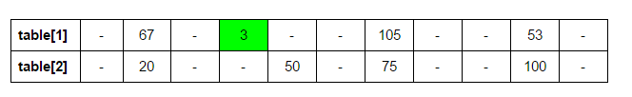
Cuckoo Hashing
Next: 105. h1(105) = 6. But 50 is already there at 6. We place 105 in table 1 & 50 in table 2 at h2(50) = 4. Now 53 has been displaced. h1(53) = 9. 75 displaced: h2(75) = 6
Next: 3. h1(3) = 3.

Slide 28
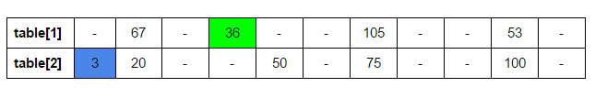

Cuckoo Hashing
Next: 36. h1(36) = 3. h2(3) = 0.
Next: 39. h1(39) = 6. h2(105) = 9. h1(100) = 1. h2(67) = 6. h1(75) = 9. h2(53) = 4. h1(50) = 6. h2(39)=3.

Slide 29
Dynamic hashing
Dynamic hashing is a method of hashing in which the data structure grows and shrinks dynamically as records are added or removed.
In traditional static hashing, the hash function maps keys to a fixed number of buckets or slots. However, this approach can lead to problems such as overflow and poor distribution of keys, especially when the number of keys is unpredictable or changes over time.
Dynamic hashing, also known as extendible hashing, addresses these issues by allowing the hash table to expand or contract as needed.
The key to dynamic hashing is the use of a directory that points to buckets. Each bucket can hold a certain number of records. When a bucket becomes full upon an insertion, it is split into two, and the directory is updated to reflect this change.
The hash function in dynamic hashing is designed to produce a binary string of digits. The system initially considers only the first few digits but can consider more digits as the table grows, effectively increasing the number of available buckets.

Slide 30
Dynamic hashing
For example, if the system starts with one bucket (represented by 0) and this bucket becomes full, it is split into two buckets represented by 0 and 1. If the bucket represented by 1 becomes full, it is split into buckets represented by 10 and 11, and so on. This way, the hash table can grow incrementally without needing to rehash all existing keys, which can be a costly operation.
Similarly, when a deletion causes a bucket to become empty, it can be merged with another bucket, and the directory can be updated to reflect this change. This allows the hash table to shrink when necessary, saving memory.
Dynamic hashing provides a flexible and efficient method for managing hash tables with a changing number of records. It avoids the problems of overflow and poor key distribution that can occur with static hashing, and it eliminates the need for costly rehashing operations.

